Slide 1
Data as a Strategic Asset
Transforming Architecture
Simplifying Decisions

Slide 2
Agenda
01
02
New Architecture Overview
Diagram
Layers & Functionalities
Artifacts & Modules
E2E Data Engineering Projects
Sales Dashboard
Churn Prediction Model
2/12

Slide 3
New Data Architecture Overview

Slide 4































Architecture Diagram Based on the requested target stack
Main Stream
Source Data Stack
Data Stewards
Enrich
Including computer vision, NLP, and IA
Operational Stack
Ingestion
Store
Process
Notes:
The proposed architecture is designed to support structured data through a batch-based ingestion model. While the current scope does not include semi-structured or unstructured data, the architecture is extensible — enabling future integration of such formats with minimal adjustments.
Streaming and IoT data are initially out of scope, but can be incorporated through the adoption of tools like Azure Event Hubs and Azure Stream Analytics, following a Lambda architecture approach for real-time processing.
The architecture is designed exclusively for internal Allianz stakeholders. While it can be extended to support third-party and external users, doing so will require additional resources, such as Azure Data Share, to enable secure data sharing.
Azure AI Services
Custom ML models training and MLOps
End User
Serverless SQL Pools
Azure Machine Learning
Analytical Stack
Pipelines
Data Lake Storage Gen2
5
10 Business Lines
+200 Analysts
+1000 Processes
Dedicated SQL Pools
Enterprise-grade semantic model and self-service BI
Serve
Scheduled / Event Triggered data ingestion
High-performance polyglot storage
Enterprise data warehouse capabilities
SAS EG
2
3
4
Azure Synapse Analytics
Power BI Premium
Oracle DB
1
6
7
Access Management
Governance
Microsoft Purview
Share
Governance Stewards
2
Azure AD
Azure AD Grous
Maintenance
Microsoft Defender for Cloud
Azure DevOps & GitHub
Jira
Confluence
Microsoft Entra ID
Microsoft Cost Management
Azure Key Vault
Azure Monitor
Azure Policy
1
3
4
Support Stream
4/12
DISCLAIMER: Fictional content created solely for assessment use.

Slide 5
Architecture Layers and Functionalities
Main Stream
Ingestion
Store
Process
Enrich
Serve
2
3
4
5
6
Layers
Tool/Service:
Azure Synapse Pipelines + Virtual Machines
Functionality:
Incremental extraction, transformation, and loading of data
Design Pattern:
Scheduled / Event Triggered
Tool/Service:
Azure Delta Lake Storage Gen2
Functionality:
Enables reliable, scalable data storage with ACID transactions and versioning
Layers: *
Silver and Bronze
Tool/Service:
Azure Serverless and Dedicated Pools
Functionality:
On-demand data processing and transformation at scale using parallel computing
Design Pattern:
Distributed Data Processing
Layers: *
Gold
Tool/Service:
Azure AI Services + Azure Machine Learning
Functionality:
Generative AI, NLP, intelligent automation, and predictive models
Design Pattern:
--
Tool/Service:
Power BI Premium
Functionality:
Dashboards and self-service reports
Design Pattern:
--
BRONZE
Functionality:
Scalable storage of original, unprocessed, and historical data
Design Pattern:
Delta Lake
SILVER
Functionality:
Cleaned and integrated data, ready for modeling
Design Pattern:
Delta Lake
GOLD
Functionality:
Modeled and performance-optimized data for analytics and BI
Design Pattern:
Star Schema
Access Management
Governance
Maintenance
Share
Data Stewards
Governance Stewards
1
2
3
4
Role-based access control and identity management
Metadata catalog, data lineage, classification, access policies
Security, monitoring, secrets management, automation and cost governance
Agile project management, documentation and cross-team collaboration
Manage the quality, accuracy, and consistency of data, ensuring it aligns with defined standards and is accessible for use.
Ensure data complies with policies and standards, overseeing data security, privacy, and access control to maintain compliance and ethical practices.
Support Stream
Roles
5/12
DISCLAIMER: Fictional content created solely for assessment use.

Slide 6

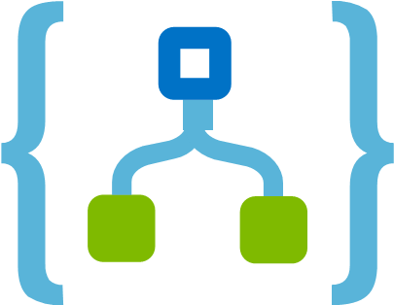


DataOps Artifacts and Modules Given the target architecture, where might there be opportunities for enhancement?
Main Stream
Opportunity
Justification
Diagram-Wise
Replace Synapse Analytics with Data Factory
Replace Virtual Machines with Azure Logic Apps
Azure Data Factory is the preferred choice for ingesting 3500 tables and 8.5 TB of data from on-premises due to its cost-efficiency, scalability, and flexibility. Unlike Synapse Pipelines, ADF uses a pay-per-use model with no need for always-on infrastructure, making it more economical for large-scale batch ingestion.
Azure Logic Apps is the preferred choice for triggering scheduled pipelines in place of virtual machines due to its serverless architecture, lower operational costs, and ease of maintenance.
Ingestion
2
Store
Fuse Gold and Silver Layers
When data transformation logic is not complex, this approach reduces redundancy and minimizes the number of pipelines and maintenance efforts. It works well in scenarios without multiple consumers or intricate business rules.
Azure Policy
3
Process
Evaluate using Spark Pools (auto-scalable) for transformation-heavy layers (Gold)
Spark Pools scale automatically and are more suitable for large-scale transformations. They can reduce long-term maintenance by separating compute and storage cleanly.
Azure Monitor
4
Enrich
Replace Azure Machine Learning with Azure ML Designer
Reduces learning curve and setup time. No need for containers, clusters, or complex scripts.
5
Microsoft Cost Management
Drivers: Reduce Maintanance and Operating Costs
6/12
DISCLAIMER: Fictional content created solely for assessment use.

Slide 7
E2E Data Engineering Projects

Slide 8
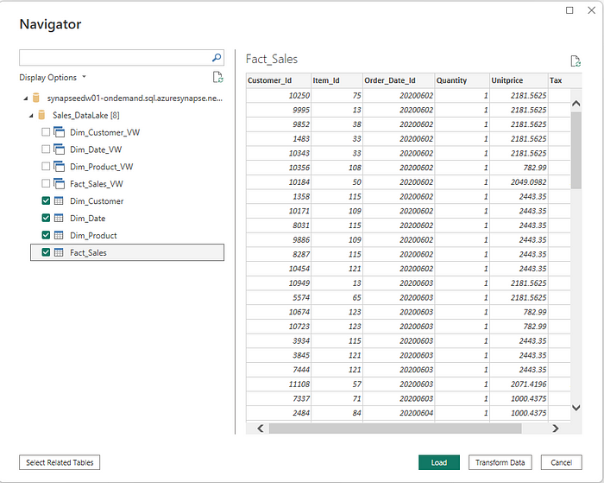
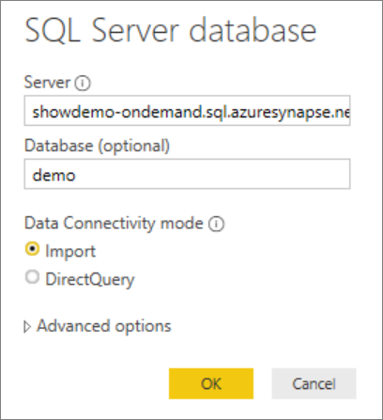

Data Model Design for Sales Dashboard
Process
Serve
client_id
client_name
client_age
client_gender
income_group
4
6
DIM Client
DIM Product
DIM Region
product_id
product_name
policy_term
term
coverage
region_id
country
state
city
FACT
sales_id
client_id
channel_id
region_id
sales_date
sales_gross_vl
discount
sales_net_vl
status
product_id
DIM Channel
DIM Time
Navigation on Synapse SQL Pools Tables and Views
channel_id
channel_type
channel_name
partner_name
date
week
month
quarter
year
Insights
Connecting to Azure Synapse Analytics SQL Pools
Performace YoY, MoM, YTD
Sales Seasonal Turns
Demographics Analysis
Policy Retention
Channel Efficiency
At-Risk Customers
Refresh schedules offset pipeline executions
8/12
DISCLAIMER: Fictional content created solely for assessment use.

Slide 9

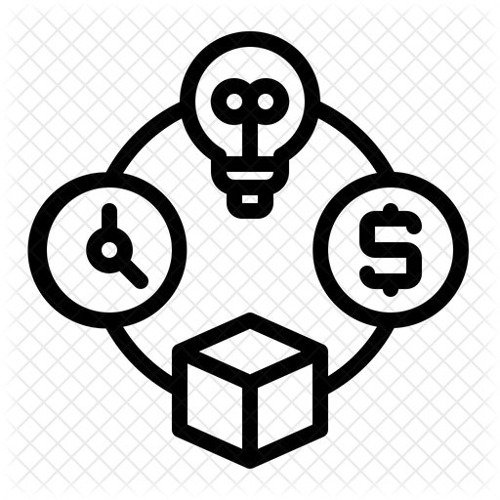


High-Level Project Plan: Sales Dashboard
Roadmap
Resources
ORGANIZATION
Phase | Week 1 |  | Week 2 |  | Week 3 |  | Week 4
Design
Build
Test
Launch
DATA TEAM
SALES TEAM
Costs
DS
DE
DA
Enablement
Operations
DSc₁
DEng₁
DAn₁
Process Owner
Stakeholders
Type | Item | Est. Cost (€/Mo)
Capex | Synapse Dedicated Pool | 1200
 | Azure VM (Triggers) | 40
 | Power BI Premium (P1) | 4700
 | GitHub Actions (CI/CD) | 40
Opex | Synapse Pipelines | 200
 | Data Lake Storage | 80
 | Azure Purview | 300
 | Azure Monitor & Logs | 50
 |  | Total: 6610
Key Activities per Phase:
Design: Requirements gathering, data model design, dashboard wireframes.
Build: Data ingestion, dimensional modeling, dashboard creation.
Test: Data validation, stakeholder review, UAT (User Acceptance Testing).
Launch: User training, go-live, production deployment, hypercare support.
DArch₁
Length: 4 – 6 weeks Max.
Team Size: 4 FTEs
Main Responsabilities per Role:
Data Engineer: Build ingestion and transformation pipelines; prepare data in Synapse.
Data Architect: Define data architecture and governance; ensure scalability and performance.
Data Analyst: Develop Power BI dashboards, KPIs, and sales analyses.
Process Owner: Define business requirements and validate dashboard deliverables.
Assumptions:
Project complexity is moderate, with standard business logic and calculations.
The primary audience is the Operations Team; Leadership and Executive Teams are not direct stakeholders at this stage.
Data will be refreshed four times per day at predefined intervals.
Manhour costs for internal resources are excluded from the cost estimation.
Initially, the project will rely solely on internal resources due to the sensitivity of the data (such as client information, margins, etc.). External consultants may be brought in if additional expertise is required.
8/11
DISCLAIMER: Fictional content created solely for assessment use.

Slide 10

Data Model Design for Churn Prediction
Process
Enrich
Feature Selection
4
5
Problem Understanding
client_id
client_name
client_age
client_gender
income_group
risk_profile
Deployment
Data Mining
DIM Client
Evaluation
LIFE CYCLE
Data Preparation
DIM Product
DIM Region
Features
product_id
product_name
policy_term
term
coverage
region_id
country
state
city
Modeling
Data Cleaning
FACT
sales_id
client_id
channel_id
region_id
sales_date
sales_gross_vl
discount
sales_net_vl
status
product_id
churn_label
Feature Engineering
DIM Channel
DIM Time
Process
channel_id
channel_type
channel_name
partner_name
date
week
month
quarter
year
4
Serve
Output
Churn Predicted (ranged 0 to 1)
6
10/12
DISCLAIMER: Fictional content created solely for assessment use.

Slide 11
High-Level Project Plan: Churn Prediction
Roadmap
Resources
ORGANIZATION
Phase | Week 1 | Week 2 | Week 3 | Week 4 | Week 5 | Week 6
Problem Understanding
Data Mining
Data Preparation
Feature Engineering
Modeling
Evaluation
Deployment
DATA TEAM
SALES TEAM
Costs
DA
DE
DS
Enablement
Operations
Type | Item | Est. Cost (€/Mo)
Capex | Synapse Serverless Pool | 600
 | Azure VM (Triggers) | 60
 | Power BI Premium (P1) | 4700
 | GitHub Actions (CI/CD) | 40
Opex | Synapse Pipelines | 200
 | Data Lake Storage | 80
 | Azure Purview | 300
 | Azure Monitor & Logs | 50
 | Azure Machine Learning | 100
 |  | Total: 6130
DAn₁
DEng₁
DSc₁
Process Owner
Stakeholders
DArch₁
Key Activities per Phase:
Problem Understanding: Define the churn problem and business objectives.
Data Mining: Gather relevant data (e.g., client interactions, transactions).
Data Preparation: Clean, transform, and organize data.
Feature Engineering: Create relevant features from raw data.
Modeling: Select and train ML models to predict churn.
Evaluation: Assess model performance using metrics (e.g., accuracy, AUC-ROC).
Deployment: Implement the model in production and monitor its performance.
Team Size: 5 FTEs
Length: 6 – 8 weeks Max.
Main Responsabilities per Role:
Data Engineer: Build ingestion and transformation pipelines; prepare data in Synapse.
Data Architect: Define data architecture and governance; ensure scalability and performance.
Data Scientist: Develop models, perform feature engineering, and analyze output.
Data Analyst: Develop Power BI dashboards, with key visualizations.
Process Owner: Define business requirements and validate model output.
Assumptions:
Project complexity is moderate, involving standard business logic and calculations.
The initiative is of medium priority, allowing for a balanced but timely execution.
The primary audience is the Operations Team; Leadership and Executive Teams are not direct stakeholders at this stage.
Historical data on customer behavior is clean and reliable enough to build a solid predictive model.
Manhour costs for internal resources are excluded from the cost estimation.
Initially, the project will rely solely on internal resources due to the sensitivity of the data (such as client information, margins, etc.). External consultants may be brought in if additional expertise is required.
11/12
DISCLAIMER: Fictional content created solely for assessment use.

Slide 12
Thank you!
GitHub Public Repository: https://github.com/Nesk95/Allianz_BusinessCase.git
Do you have any questions?

